Slide 1

TabExpansion Plus Plus
in examples
Bartosz Bielawski, Optiver

Slide 2
Agenda
Why TabExpansionPlusPlus?
TabExpansion++ - the past
Mix mode – how to survive NOW?
TabExpansionPlusPlus – the future

Slide 3
Why TabExpansionPlusPlus?
Many ways to skin the cat
Use right tool for the job
Challenges

Slide 4
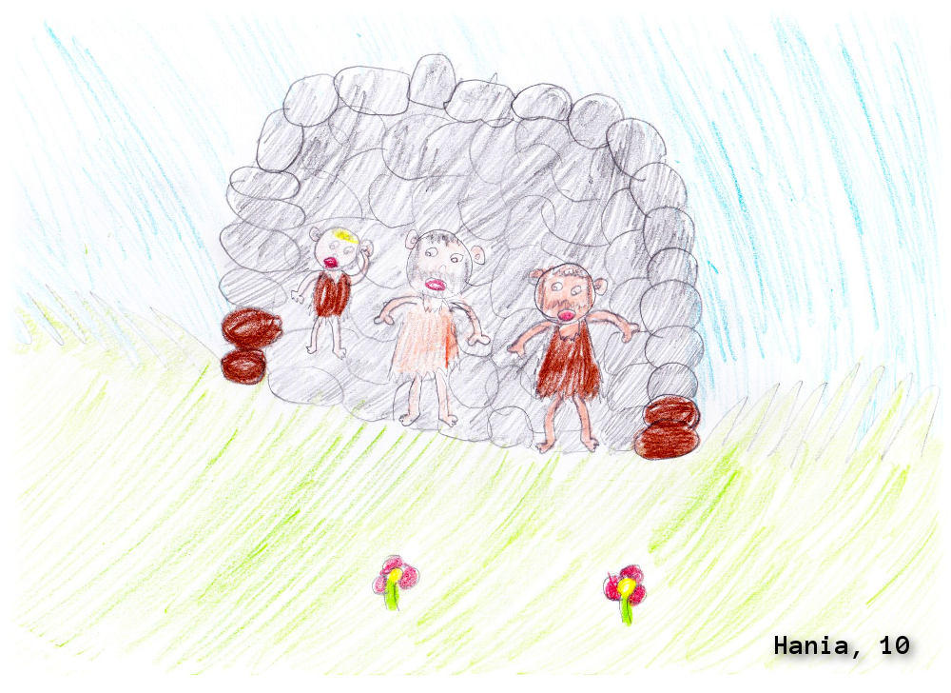
Demo

Slide 5
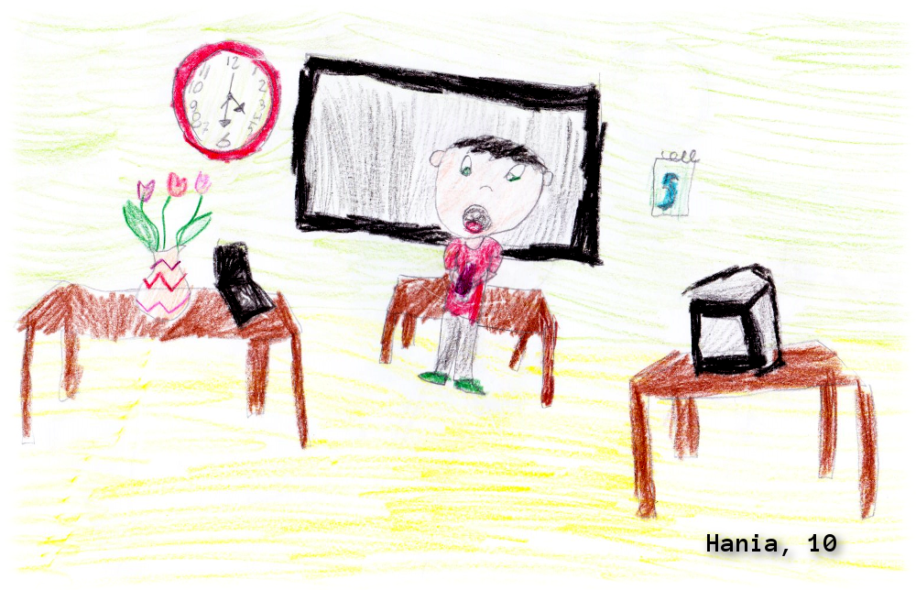
Demo

Slide 6

Demo

Slide 7

Summary
Pick the right tool for the job
Stay in the current time
Use future if possible/justified

Slide 8
Next Steps...
Now: 15 min break
Grab a coffee
Stay here to enjoy next presentation
Change track and switch to another room
Ask me questions or meet me in a breakout session room afterwards

Slide 9
about_Bartek.help.txt
Windows Engineer @ Optiver
MVP: PowerShell Cloud Something Something
Book author: „PowerShell 5.0 Biblia“ (PL)
PowerShellMagazine.com/PowerShellPL.NET
Optiver is hiring!
DevOps Engineer
…?

